Slide 1

Welcome Onboard!

Slide 2

Welcome on board!
Dear Valued Customer,
Thank you for choosing Maersk Line, we are proud to welcome you onboard.
As a new customer, we recognize that you may need some help to get to know our products, services and processes. We are committed to giving our customers a positive experience, so our dedicated onboarding team will work closely with you as you make your first bookings with Maersk Line. Our Customer Service team will ensure that your specific queries and expectations as a new customer are met promptly by our experienced staff.
As a leading ocean carrier we offer customers a second-to-none transportation service. With more than 500 container vessels and 1,900,000 containers we strive to ensure that you get a reliable worldwide coverage.
At your disposal is a vast and modern fleet of containers and vessels. From straight forward dry containers to state-of-the-art controlled atmosphere reefers and remote container management, we have the size and type of container to suit your needs. Our vessels are amongst the most modern, secure and environmentally friendly to sail the oceans. Your cargo is therefore assured a smooth and safe voyage.
With our advanced e-business solutions you have access to accurate, online information and the opportunity to do business at your convenience. We offer you a comprehensive suite of business tools on the web From quoting to booking and invoicing my.maerskline.com will guide you through the full shipping process.
If you have any further questions which are not answered here, please feel free to contact us.
We look forward to working with you.
Yours Sincerely,
Your Maersk Line Customer Service Team
Maersk Guinea-Bissau
Thank you for choosing Maersk Line, we are proud to welcome you as our customer.

Slide 3

Agenda
In the following slides you will find information about the following topics:
Overview of our customer service team and contact details
How to register on our website
Online notifications
Online overview of your shipments and all related activities
Online overview of your invoices
Local information

Slide 4
Contacting Us
Customer Service
For any day to day enquiries, please reach out to our Customer Service team via email or phone.
Tel: +245955397762
Email: gw.export@maersk.com / gw.export@safmarine.com for export queries and gw.import@maersk.com / gw.import@safmarine.com for import queries.
Our customer services teams are available Mo-Fri 8:30 am - 4:30pm.
Sales
Our Sales team are on hand for any questions about Pricing, Contracts or New Routes/ Product information.
Tel: +245955514304 / +245955502450
Online Services
Our website & mobile Apps (Maersk/Safmarine Apps & Myfinance mobile App) contains all of the information to support your shipping needs. In addition to finding out schedules and vessel information, you can request quotes, place bookings, submit shipping instructions online… and many more.
Our onboarding website http://maersklineonboarding.com will guide you through each of the process steps which are relevant for your business.
You will also find the answer a wide variety of questions on our website:
www.maerskline.com

Slide 5

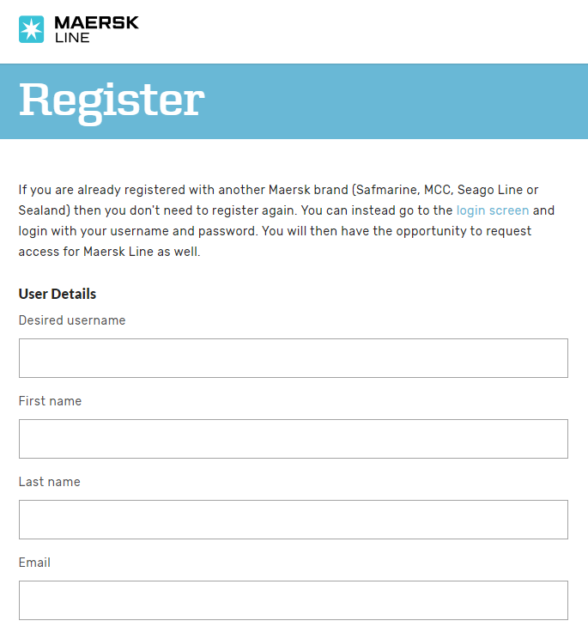
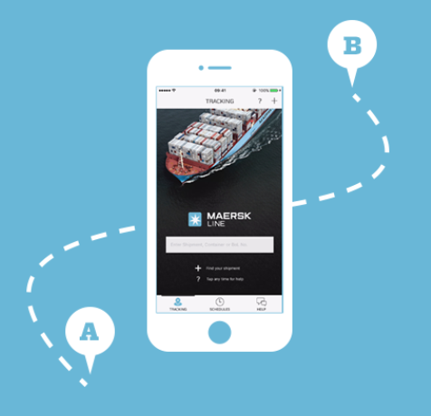
REGISTRATION PROCESS
Register to our website via below link for 24/7 access to your shipments
https://my.maerskline.com/portaluser/#register
Upon registration, our team will check your details and once approved will send you a confirmation email. In that email, you will find a link to set your password.
Now you are ready to log in with your chosen username and set password to our website via below link.
https://my.maerskline.com/portaluser/#login
Maersk Line on the go!
http://news.maerskline.com/ebusiness-mobileapp
The Maersk Line app means you can now manage shipments and track cargo on the move thanks to push notifications and real time shipping information, while also being able to share vital information like estimated time of arrival.
You'll find shipping easier than ever before.
Propel your ambitions with our new app now.

Slide 6
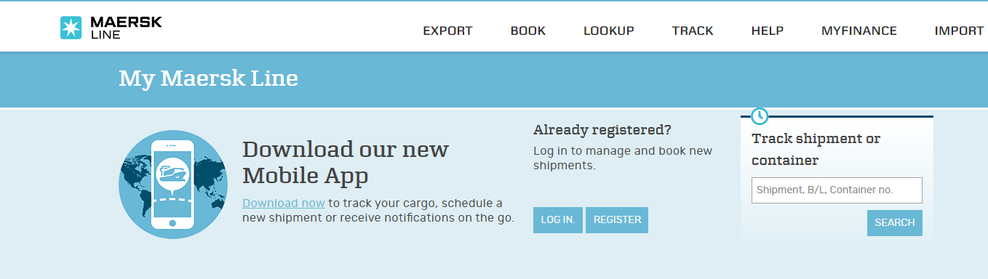
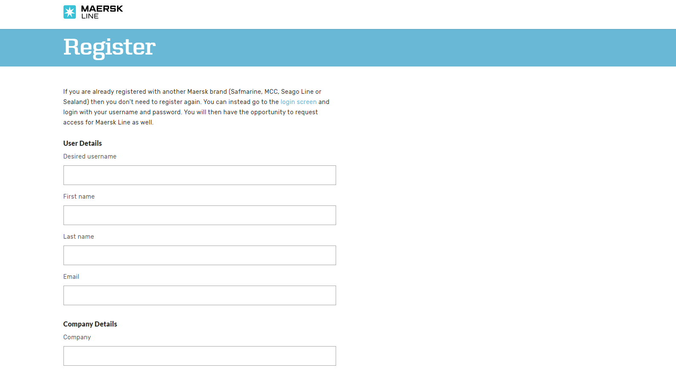
Online registration
Would you like to use all the useful functionalities of our website?
Please follow these steps to sign up and start using our website, my.maerskline.com.
Please sign up by clicking on this link https://my.maerskline.com/ and then on the register button as shown in below picture
Please fill in the information required in the registration form, then click submit and we will confirm your user name and password in a very short time.

Slide 7
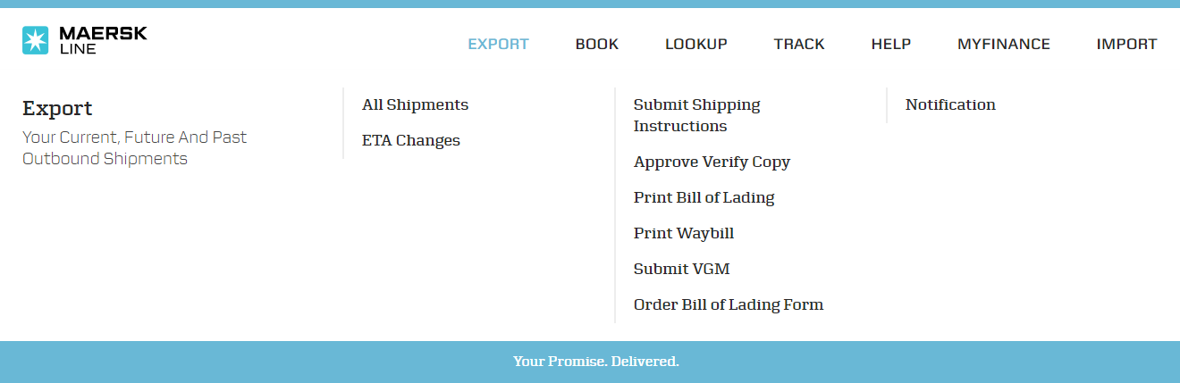
Our website
Our website, my.maerskline.com, provides a wide range of useful functionalities, such as:
Quote look-up
Vessel schedules
Container tracking
Booking Creation
Shipping instructions
BL Amendments
BL “at home” printing
……… and many more
Ready to try it? Click on this link for a complete online guide on how to use all these functionalities http://www.maersklineonboarding.com/

Slide 8
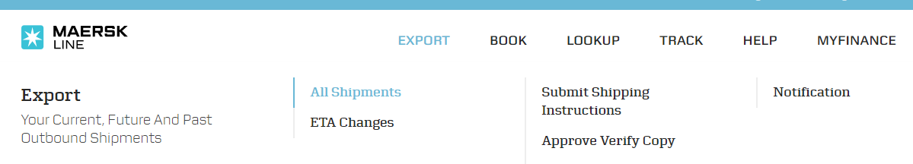
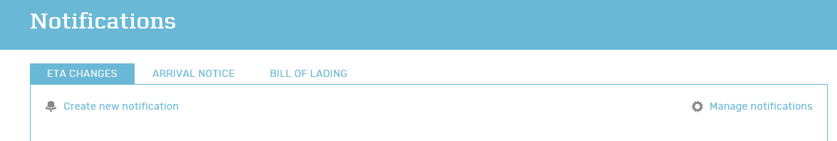
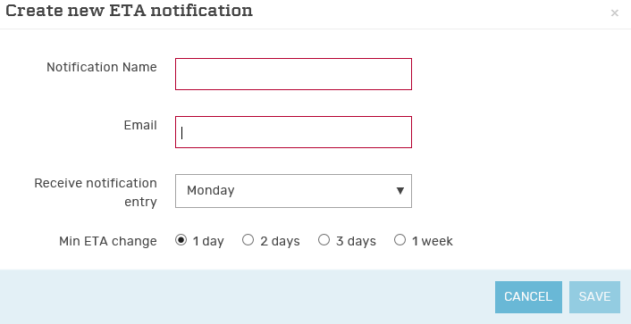
Automatic notifications
Would you like to be notified instantly if the ETA of your shipments changes?
Please subscribe to the ETA notification on my.maerskline.com following these steps:
Once you log in to our website, my.maerskline.com, using your new user name and password you will be able to choose what type of information to receive and when to receive it related to your shipments by following the steps described below
1. Click on “Export” and then on “Notifications”
2. Click on “create new notification”
3. Choose the notification options you prefer and click “save”

Slide 9
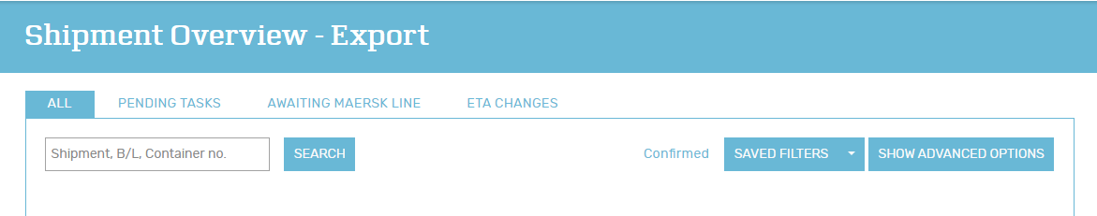
Shipments overview
Would you like to have a complete overview of the status of your shipment?
You can, on my.maerskline.com. Here is how:
Once you log in to our website, my.maerskline.com, you will be able to find a complete overview of all your shipments
Click on “Export” and then on “All shipments”
In the “All shipments” overview you can see all your shipments as well as check what are the activities pending from your side and the activities pending from our side. You can also see if the initial ETA has changed for any of your shipments

Slide 10
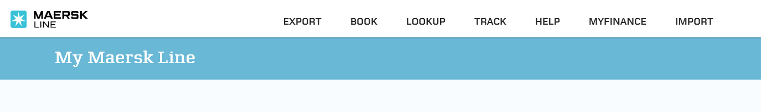
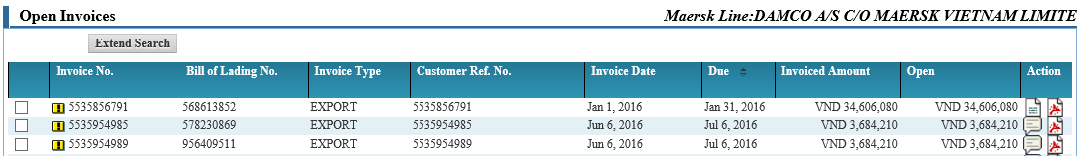
Invoices
Would you like to have complete access to your invoices at all times?
You can, on my.maerskline.com. Here is how:
Once you log in to our website, my.maerskline.com, you will be able to find a complete overview of all the invoices related to your shipments, in the myfinance section, as shown below. Not only you will be able to see and download the invoices but also dispute them in case something is wrong.
Click on Myfinance
From your open invoices overview select the invoice you would like see or to download by clicking the pdf icon on the right hand side
If something is wrong you can dispute the invoice directly online by clicking the action icon next to the pdf. A new window will open where you can provide a brief description of the issue. In case you notice more than one invoice wrong for the same reason, you can select all of them and click on “mass dispute” at the bottom of the page in order to dispute them all at once.

Slide 11
Local information
Would you like more information about our company and/or country specific information?
Please visit our general website: www.maerskline.com
Country specific information can be found on country level by selecting the desired country. You can find this by clicking on the ‘contact’ button on the right. If you require any assistance or need additional information please do not hesitate to contact us

Slide 12

Your promise. Delivered.

